Slide 1



Regional Baseline Measures
Region 8

Slide 2
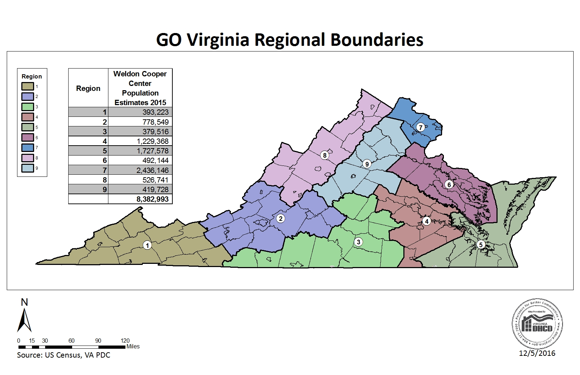

Slide 3
Region 8
Counties of:
Augusta, Bath, Clarke, Frederick, Highland, Page, Rockbridge, Rockingham, Shenandoah, Warren
Cities of:
Buena Vista, Harrisonburg, Lexington, Staunton, Waynesboro, Winchester

Slide 4
Data Included
Population
  Population Trends
  Components of Population Change
Income and Wealth
  Per Capita Income
  Poverty
Employment
  Total Employment Trends
  Unemployment
Economic Sectors
  Employment Trends by Industry Sector
  Relative Concentration (Location Quotients) by Sector
  Wages by Industry Sector

Slide 5
Data Included
Labor Force
  Labor Force Participation
  Commuting
  Educational Attainment
  Educational Awards
Firm Growth
  Jobs Created by Young Companies (5 years old or less)
  Jobs Created by Older Companies (greater than 10 years old)
  Jobs Created by Small Companies (less than 20 employees)
  Sole Proprietorships
Local Government Costs
  Average Cost of Government Services

Slide 6
Population

Slide 7
Population Trends

Slide 8
Population Trends

Slide 9
Components of Population Change

Slide 10
Components of Population Change

Slide 11
Income and Wealth

Slide 12
Per Capita Income

Slide 13
Per Capita Income

Slide 14
Poverty

Slide 15
Poverty

Slide 16
Employment

Slide 17
Total Employment Trends

Slide 18
Total Employment Trends

Slide 19
Unemployment

Slide 20
Employment Sectors

Slide 21
Employment Trends by Industry Sector

Slide 22
Employment Trends by Industry Sector
*Additional data available in accompanying spreadsheet for the years: 1996,2000,2005,2010,2015

Slide 23
Industry Wages by Sector (1996)
* Wages in 2015 dollars

Slide 24
Industry Wages by Sector (2000)
* Wages in 2015 dollars

Slide 25
Industry Wages by Sector
(2005)
* Wages in 2015 dollars

Slide 26
Industry Wages by Sector
(2010)
* Wages in 2015 dollars

Slide 27
Industry Wages by Sector
(2015)

Slide 28
Labor Force

Slide 29
Labor Force Participation

Slide 30
Labor Force Participation

Slide 31
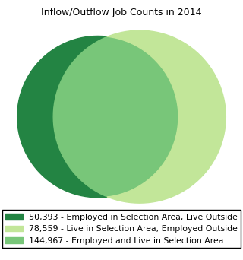
Commuting (Inflow/Outflow)

Slide 32
Commuting
(Inflow/Outflow)
*Additional data available for each year 2002-2014 in accompanying spreadsheet

Slide 33
Commuting
(Inflow/Outflow)

Slide 34
Commuting
(Inflow/Outflow)
Source: US Census Bureau, Longitudinal Employer-Household Dynamics OnTheMap, 2014

Slide 35
Educational Attainment

Slide 36
Educational Attainment

Slide 37
Educational Awards

Slide 38
Educational Awards

Slide 39
Educational Awards

Slide 40
Firm Growth

Slide 41
Jobs Created by Young Companies
(5 years old or less)

Slide 42
Jobs Created by Young Companies
(5 years old or less)

Slide 43
Jobs Created by Older Companies
(greater than 10 yrs. old)

Slide 44
Jobs Created by Older Companies
(greater than 10 yrs. old)

Slide 45
Jobs Created by Small Companies
(less than 20 employees)

Slide 46
Jobs Created by Small Companies
(less than 20 employees)

Slide 47
Sole Proprietorships
(as a percent of total employment)

Slide 48
Sole Proprietorships

Slide 49
Local Government Costs

Slide 50
Average Cost of Government Services
(Per Capita Local Government Expenditures)

Slide 51
Average Cost of Government Services
(Per Capita Local Government Expenditures)

Slide 52
Thank You
Terry L. Clower Ph.D. – tclower@gmu.edu
Mark C. White Ph.D. – mwhite@gmu.edu
Spencer A. Shanholtz – sshanhol@gmu.edu
cra.gmu.edu
@GMU_CRA

